Slide 1
Basic Tools of Process Analysis
Notes:
1

Slide 2
Eight Basic Measurement Tools for PDCA Improvement
  Process charts (Flow diagrams)
  Check sheet
  Cause and effect diagram
  Pareto charts
  Run (Trend) charts
  Histograms
  Scatter diagram
  Statistical process control chart
  Get a copy of The MEMORY JOGGER from photocopier

Slide 3

Kaizen Blitz Approach
A continuous group effort to rapidly compress time - eliminating or greatly reducing waste to increase customer satisfaction.
Usually three or five days activity.
Improvements are implemented and standardized.

Slide 4
Most Widely Used Tools for TQM
Quality Function Deployment
  House of Quality
5 WHY’s
Pareto charts
Checklists
Process flowcharts
Cause-and-effect diagrams
Statistical process control
Affinity Diagrams
Interrelationship Digraph
Tree Diagram
Notes:
34

Slide 5
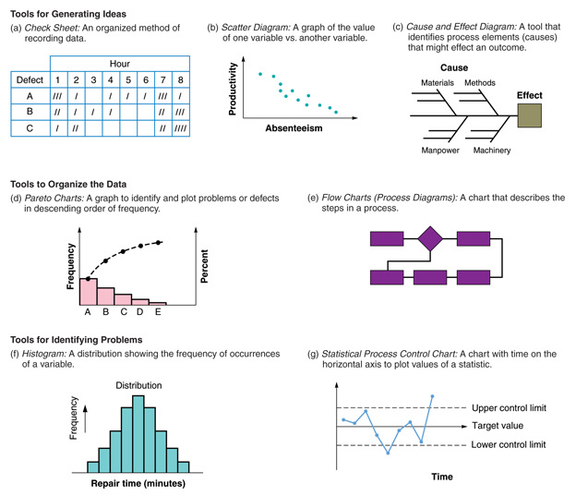
Eight Tools Continued
Run Charts
Measure
Time

Slide 6
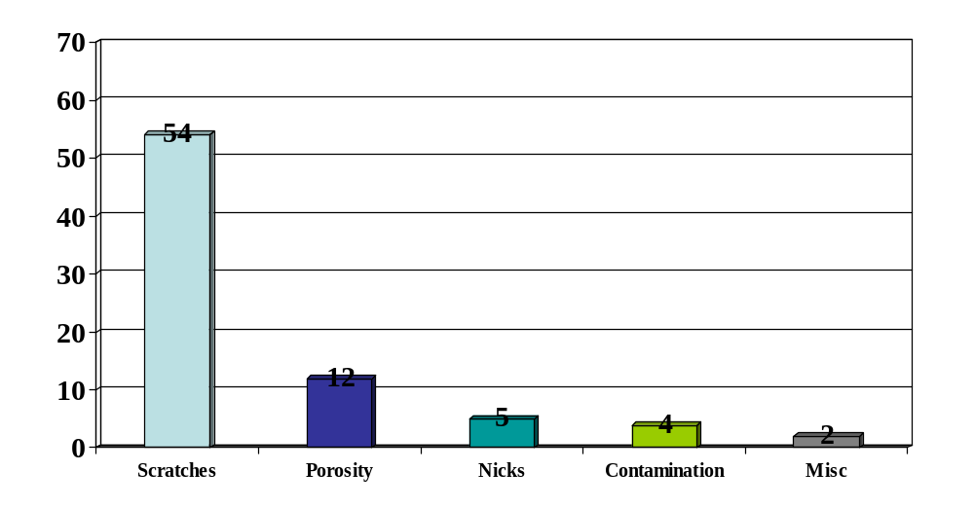
Pareto Analysis of Glass Defects
Frequency (number)
72%
16%
5%
4%
3%
Causes, by percent of total defects
Notes:
53

Slide 7
Process Chart
Shows sequence of events in process
Depicts activity relationships
Has many uses
  Identify data collection points
  Find problem sources
  Identify places for improvement
  Identify where travel distances can be reduced
Notes:
54

Slide 8
Process Chart Example
SUBJECT: Request tool purchase
Dist (ft)
Time (min)
Symbol
Description
⇨□
D
∇
Write order
○⇨□
D ∇
On desk
75
○
➔
□
D
∇
To buyer
○⇨
D
∇
Examine
○ = Operation; ⇨ = Transport; □ = Inspect;
D = Delay; ∇ = Storage

Slide 9
Cause and Effect Diagram
Used to find problem sources/solutions
Other names
  Fish-bone diagram, Ishikawa diagram
Steps
  Identify problem (effect) to correct
  Draw main causes for problem as ‘bones’
  Ask ‘What could have caused problems in these areas?’ Repeat for each sub-area.
Notes:
56

Slide 10
Cause and Effect Diagram Example
Problem
Too many
defects
Notes:
57

Slide 11
Cause and Effect Diagram Example
Method
Manpower
Main Cause
Too many
defects
Material
Machinery
Main Cause
Notes:
58

Slide 12
Cause and Effect Diagram Example
Method
Manpower
Drill
Over
Time
Too many
defects
Wood
Steel
Lathe
Material
Machinery
Sub-Cause
Notes:
59

Slide 13
Cause and Effect Diagram Example
Method
Manpower
Tired
Drill
Over
Slow
Time
Too many
defects
Old
Wood
Steel
Lathe
Material
Machinery
Notes:
60

Slide 14
Statistical Process Control (SPC)
Uses statistics & control charts to tell when to adjust process
Developed by Shewhart in 1920’s
Involves
  Creating standards (upper & lower limits)
  Measuring sample output (e.g. mean weight)
  Taking corrective action (if necessary)
Done while product is being produced
Notes:
61

Slide 15
Statistical Process Control Steps
Produce Good
Start
Provide Service
No
Assign.
Take Sample
Causes?
Yes
Inspect Sample
Correct Process
Create
Find Out Why
Control Chart
Notes:
62

Slide 16
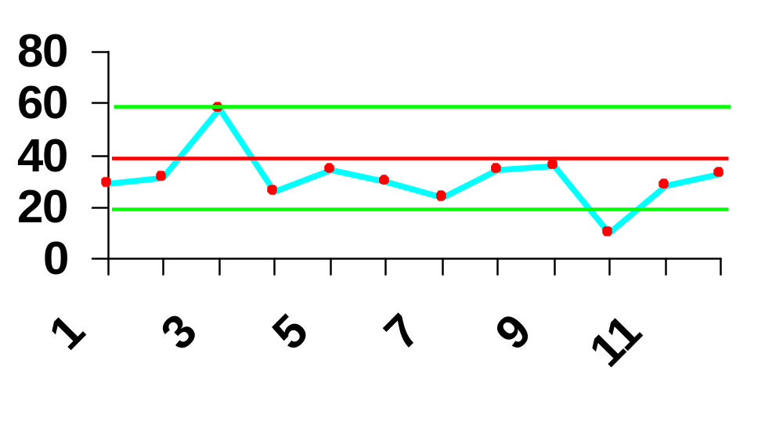
Control Chart Example
UCL
LCL
0 3 5 7 9 11
Notes:
63

Slide 17
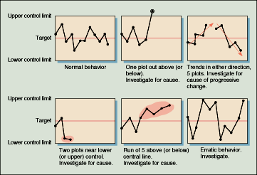
Patterns to Look for in
Control Charts

Slide 18

Quality Circles
Group of 6-12 employees from same work area
Meet regularly to solve work-related problems
  4 hours/month
Facilitator trains
& helps with
meetings
Notes:
25

Slide 19
5S – A starting point for Kaizen
Sort – Separate out all that is unnecessary and eliminate it.
Straighten – Put essential things in order so that they can be easily accessed.
Scrub – Clean everything – tools and workplaces – removing stains, spots, debris, and eradicating sources of dust.
Systemize – Make cleaning and checking routine.
Standardize – Standardize the previous four steps to make the process one that never ends and can be improved upon.

Slide 20
International Quality Standards
Industrial Standard Z8101-1981 (Japan)
  Specification for TQM
ISO 9000 series (Europe/EC)
  Common quality standards for products sold in Europe (even if made in Pakistan.)
ISO 14000 series (Europe/EC)
  Standards for recycling, labeling etc.
ASQC Q90 series; MILSTD (U.S.)
Malcom Baldridge National Quality Award (U.S.)
Notes:
16

Slide 21
Affinity Diagram
A planning tool which gathers large amounts of language data (ideas, opinions, issues, etc.), organizes it into sub-groupings based on the natural relationship between each item, and defines groups of items.
BENEFITS
Encourages true participation.
Ideas are not lost.
Creative, rather than logical.
Groups items that are naturally related.

Slide 22
Affinity Diagram –
Constructions Steps
Assemble the right team
Four to eight people
Varied perspectives
Creative, open-minded members
Phrase Issues to be Considered
Broad, neutral statements
Clearly stated, well understood
No one word cards
Generate and Record Ideas
Record on a post-it note, write clearly
Go around the table, if no idea say “pass”
Keep on collecting ideas until everybody has said “pass”
No discussion, no comments
Randomly Layout Completed Cards
On wall, table, etc.
Sort the Cards into Related Groupings
Quick response, gut reaction
Team consensus
Create Header Cards
Concise but complete
No one word headers
Make sense standing alone
Capture essential link in all ideas beneath it as well as what cards are saying about that link
Place at top of each grouping
Turn sub-themes into sub-headings
Draw the Finished Affinity Diagram
Draw lines connecting headers, sub-headers, and all cards beneath them
Bring together related groupings
Review by team

Slide 23
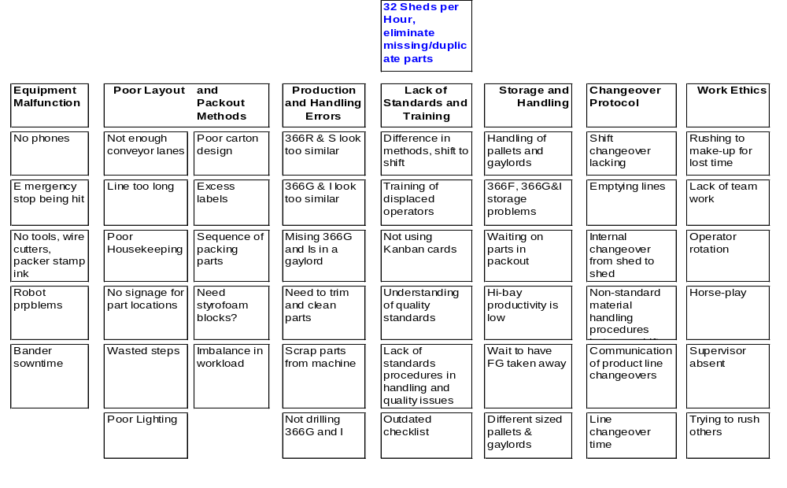
Affinity Diagram

Slide 24
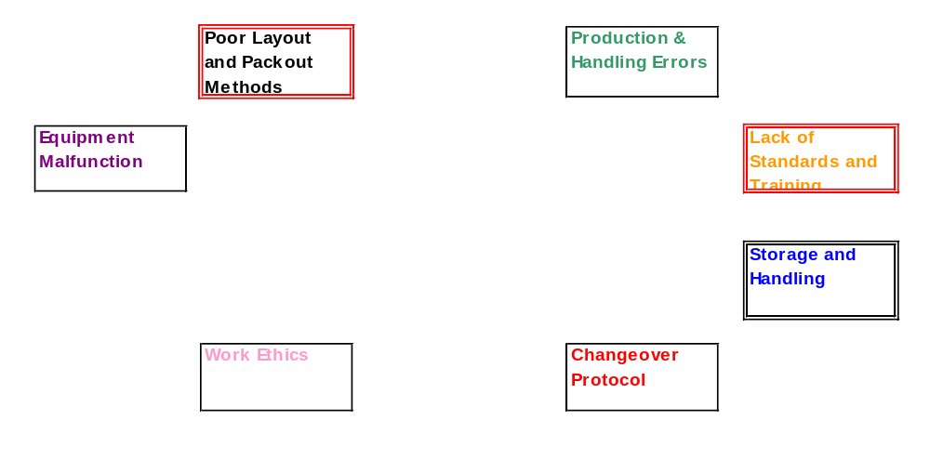
Root Cause Analysis

Slide 25
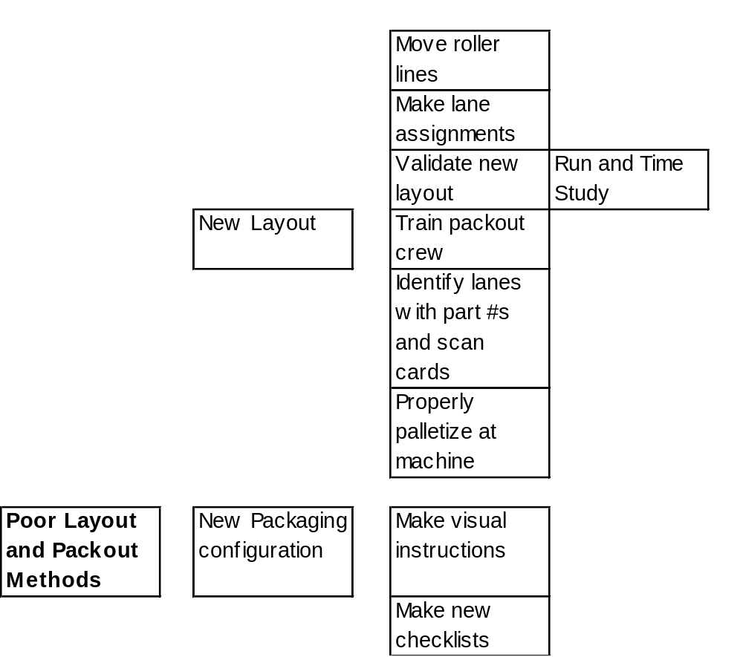
Solutions Tree

